Slide 1
Non-revisiting Coverage Task with Minimal Discontinuities for Non-redundant Manipulators
Tong Yang, Jaime Valls Miro, Yue Wang, Rong Xiong
Robotic Laboratory, Zhejiang University
Centre for Autonomous Systems (CAS), University of Technology Sydney
Robotics: Science and Systems 2020

Slide 2
Problem
Given an object of arbitrary shaped, follow a path to completely traverse its surface with a non-redundant manipulator, whilst minimising the number of end-effector lift-offs.
Or the Non-revisiting Coverage Path Planning

Slide 3
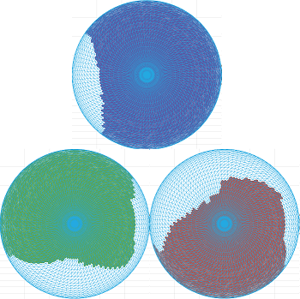
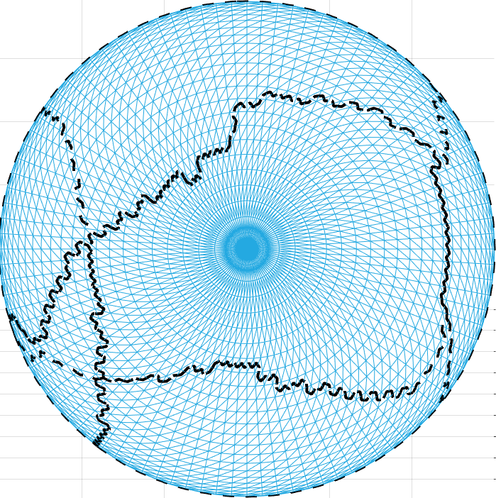
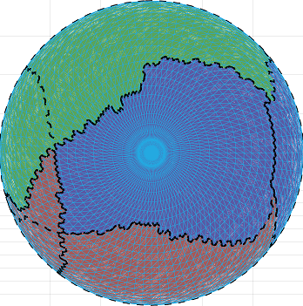
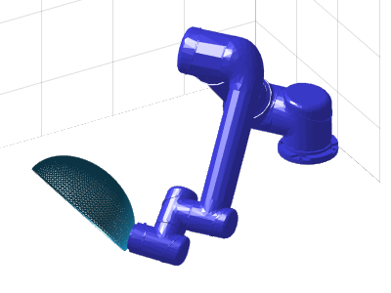
Previous Work Problem Modeling
Given known environment settings
Use colours to represent IK solutions
Model the problem as a graph colouring scheme
Solve the colouring problem
Simple objects
Consider small set of task constraints
Thus overlook the existence of non simply-connected cells
URL: https://arxiv.org/abs/2001.09577v1

Slide 4
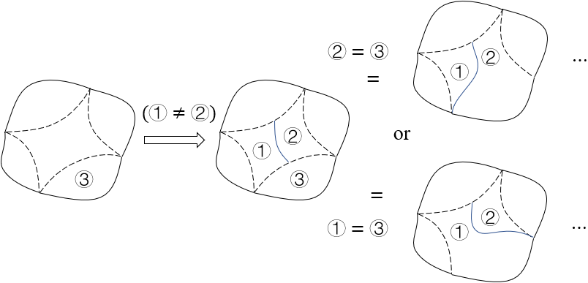
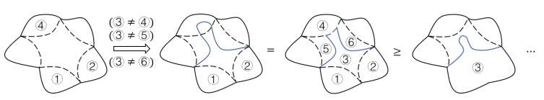
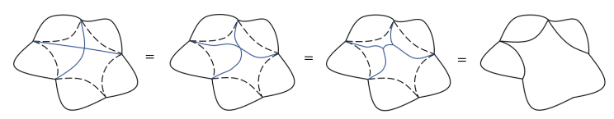
Previous Work Finiteness of Solving Simply-connected Cells
No need to have cutting path starting or ending at the middle of edges
No need to have cutting path stretching across edges
Only applicable for
simply-connected cells
No need to have intersecting cutting paths
URL: https://arxiv.org/abs/2001.09577v1

Slide 5
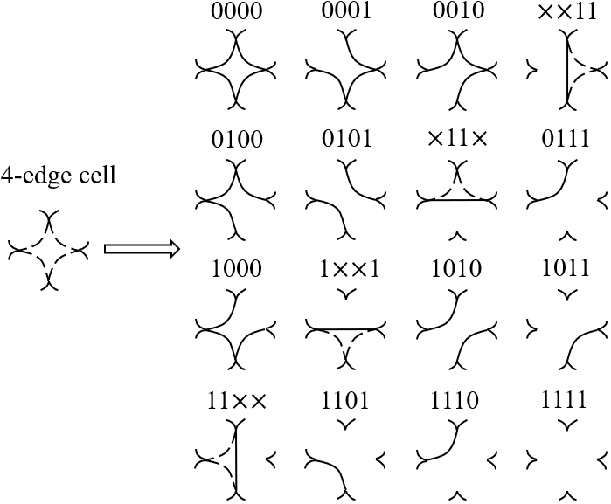
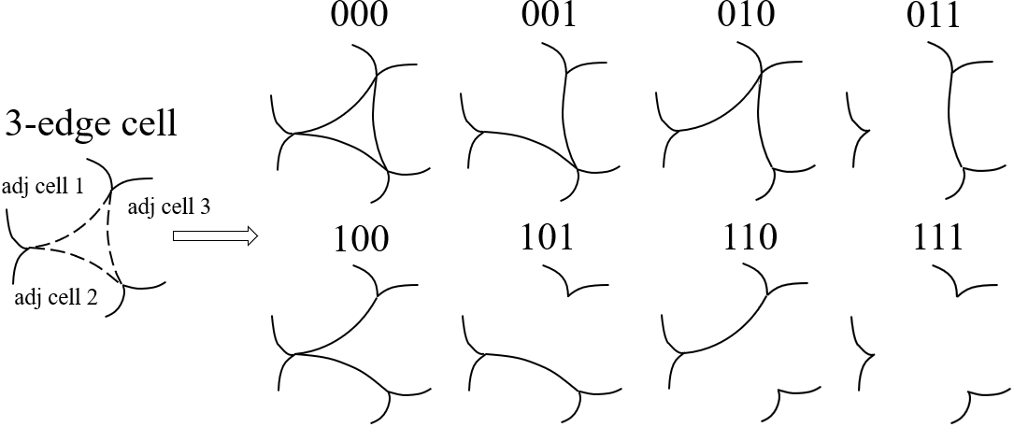
Previous Work Simply-connected Cells – Cell Subdivision
For a simply-connected cell with $K$ edges, the number of divisions is $Φ\left(K\right)=2^{K}$
URL: https://arxiv.org/abs/2001.09577v1

Slide 6
Contribution 1: Problem Modeling
The NCPP problem with least discontinuities can be modelled as a topological graph as long as:
A point contact between surface and the end-effector is assumed
Singular configurations and their neighbors can be discarded
Constraints are defined in joint-space with thresholds satisfying strict inequalities.
(See paper for further details and proof)

Slide 7
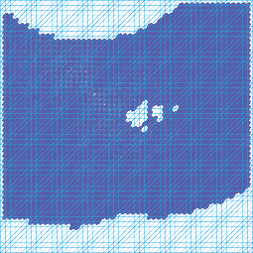
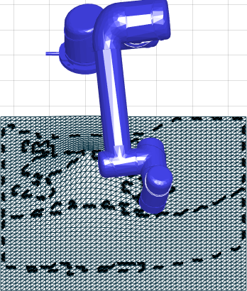
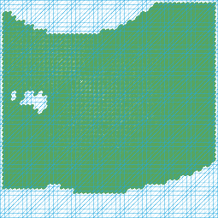
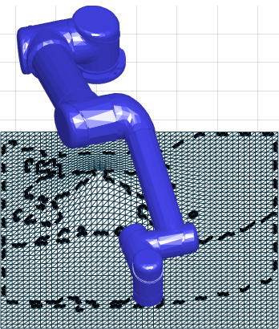
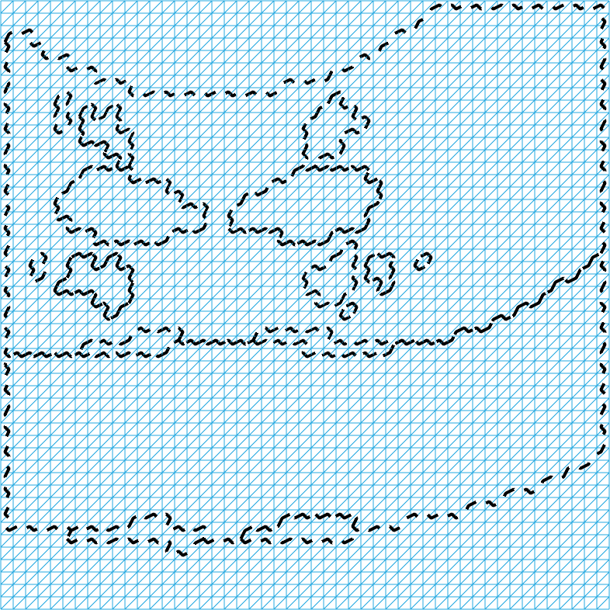
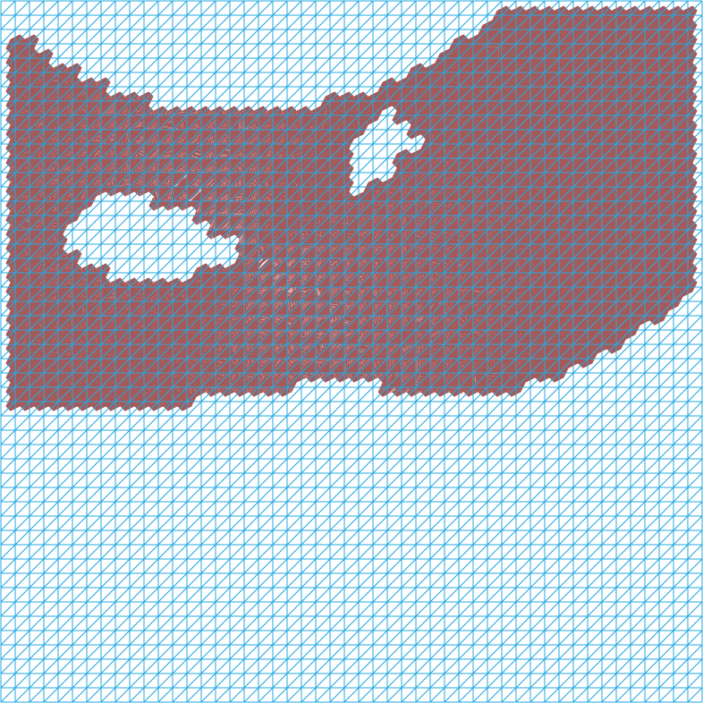
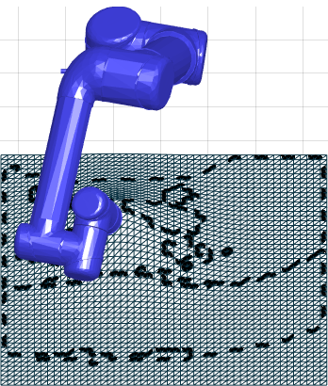
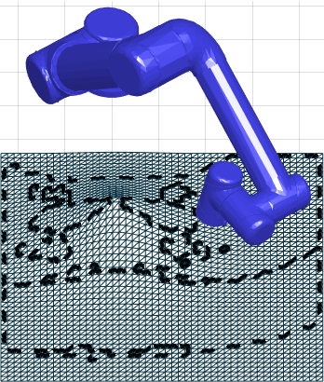
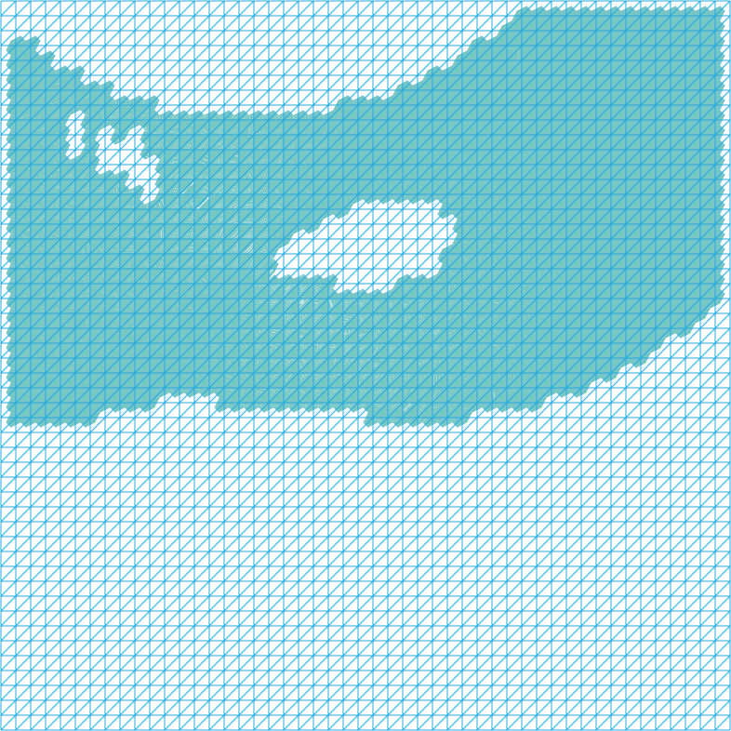
Contribution 1: Problem Modeling Example of non Simply-connected Cells due to Collision
“Holes” in cells appear due to collision between manipulator and obstacle
initial topological graph
Manipulator about to hit a “hilly terrain”

Slide 8
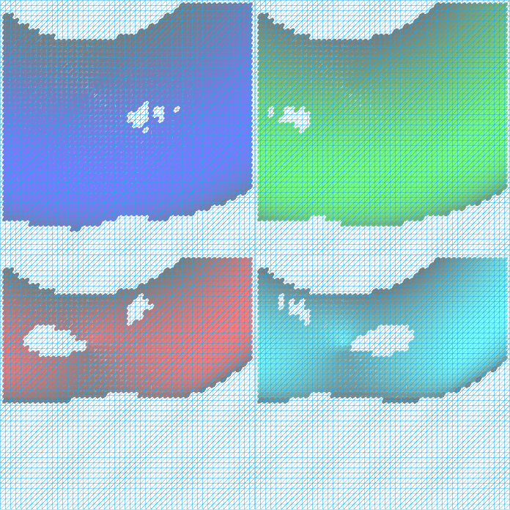
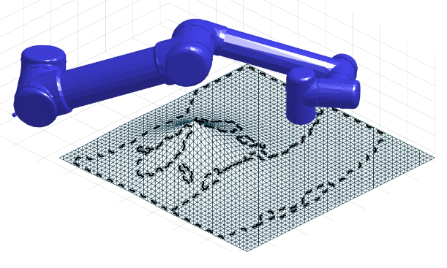
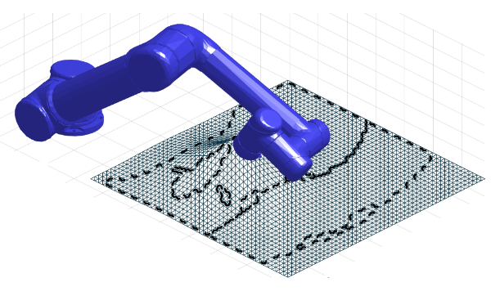
Contribution 1: Problem Modeling Example of non Simply-connected Cells due to Non-binary Metrics
Metric: configuration manipulability
High manipulability
(brighter color)
Low manipulability
(darker color)
Arbitrary metrics produce complex topological graphs.

Slide 9
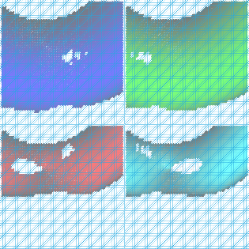
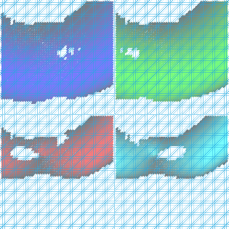
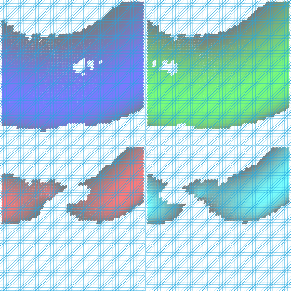
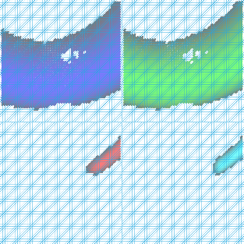
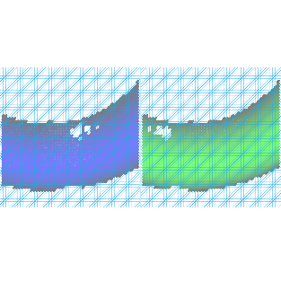
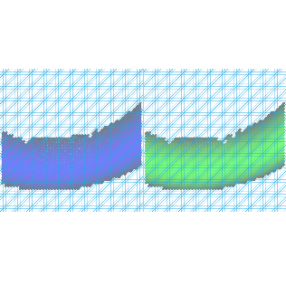
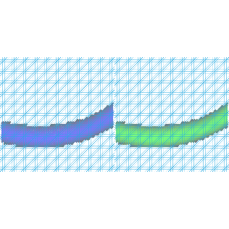
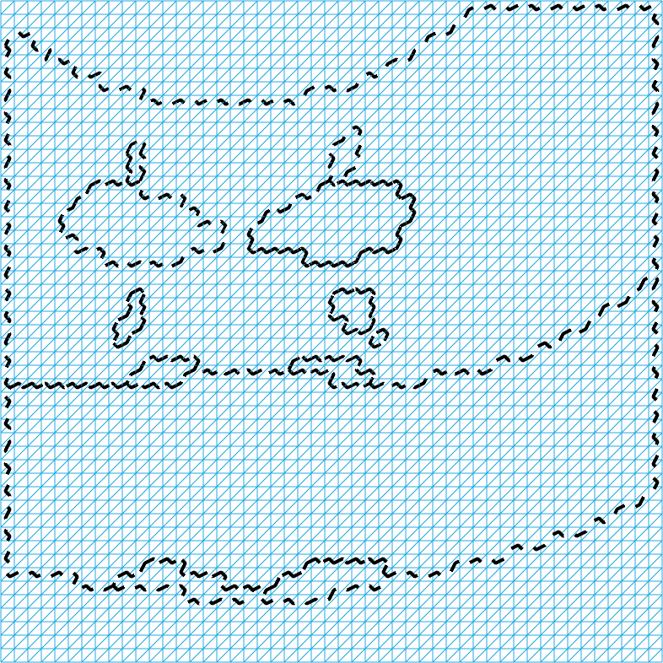
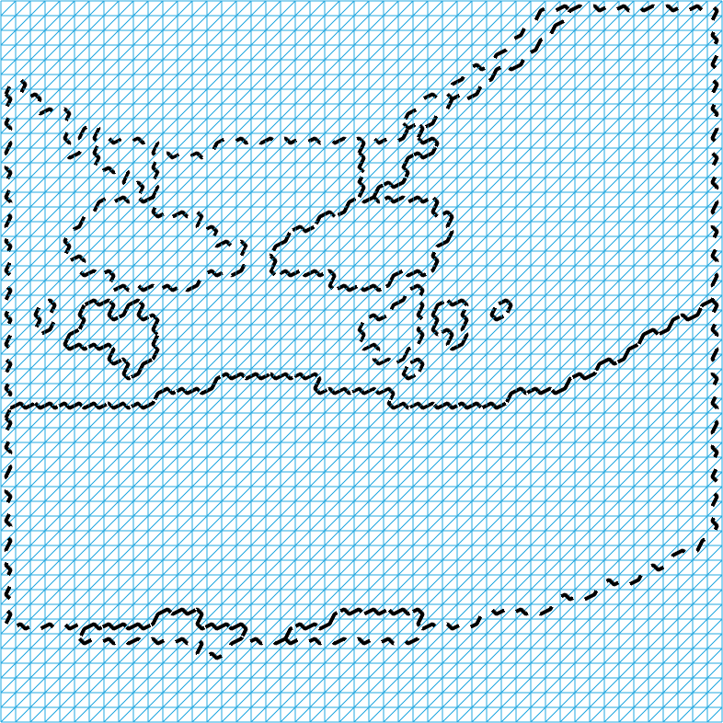
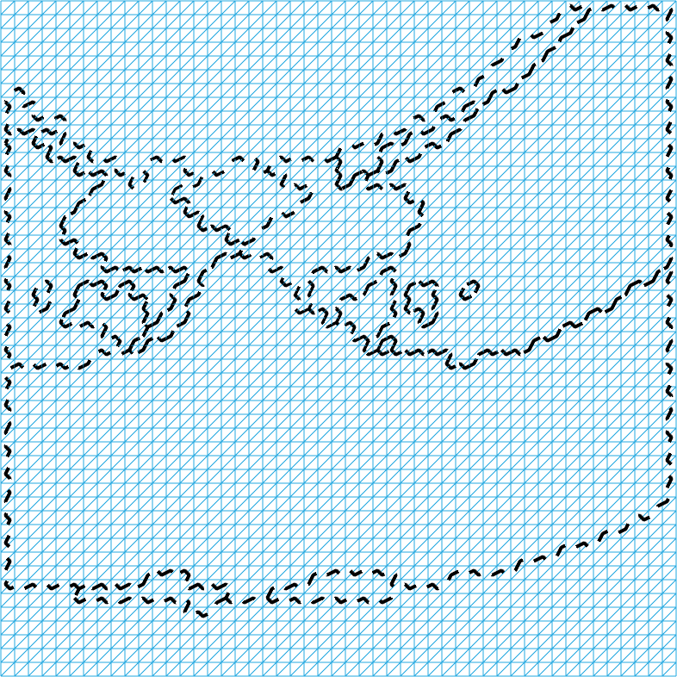
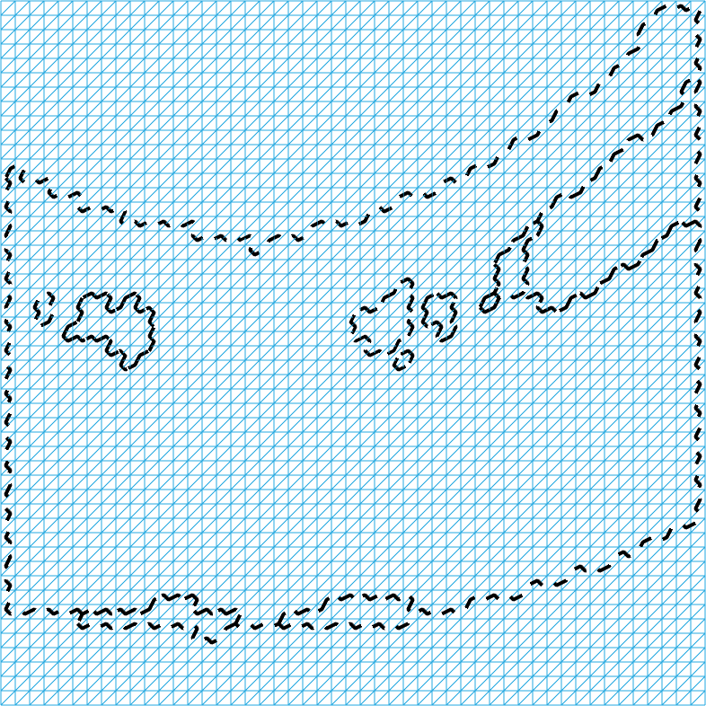
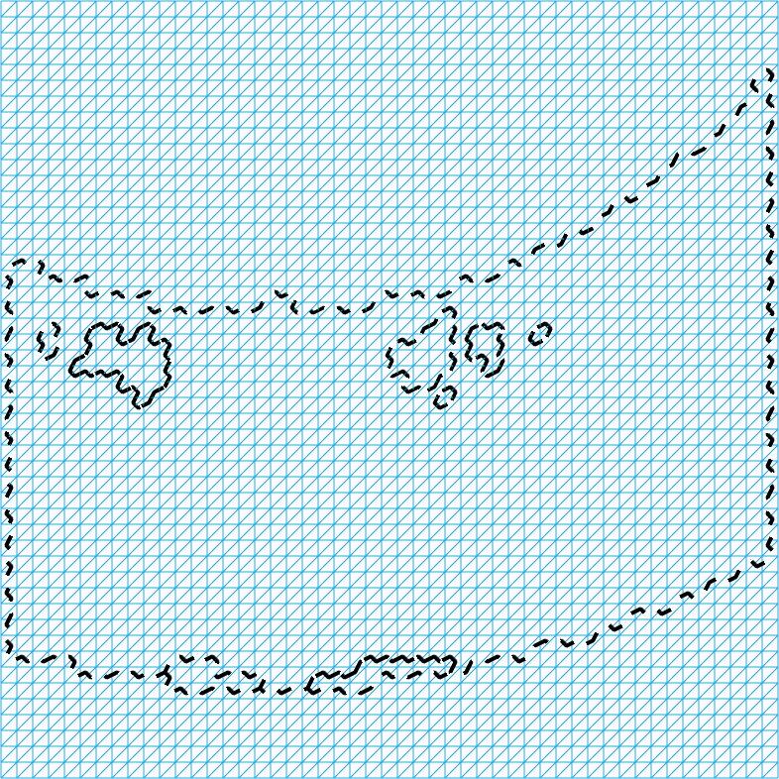
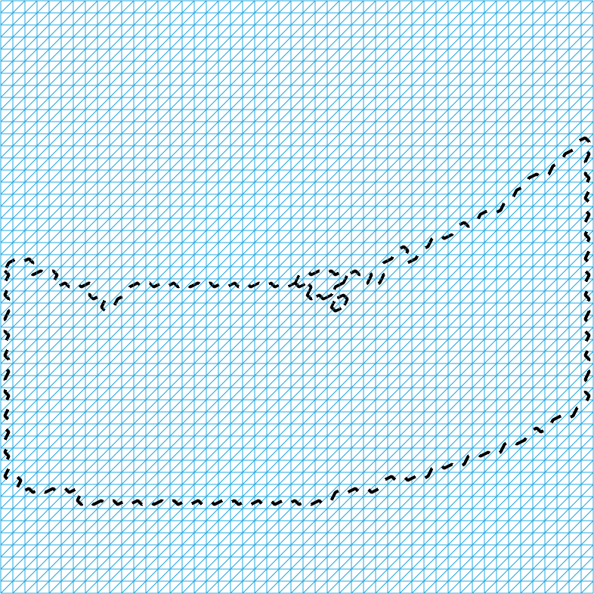
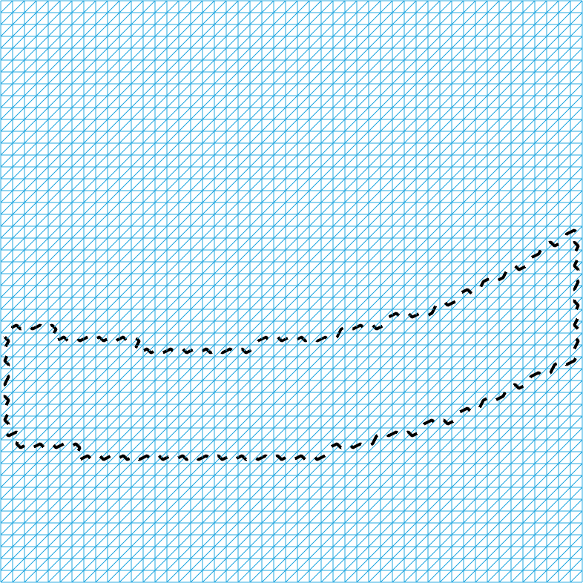
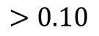
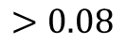
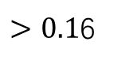
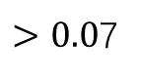
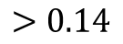
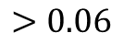
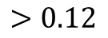
Contribution 1: Problem Modeling
Topological graphs with different manipulability thresholds
$$>0.06$$
$>0.0$7
$$>0.08$$
$$>0.10$$
$$>0.12$$
$$>0.14$$
$>0.1$6
(Note: all wrist-flipped configurations become invalid)

Slide 10
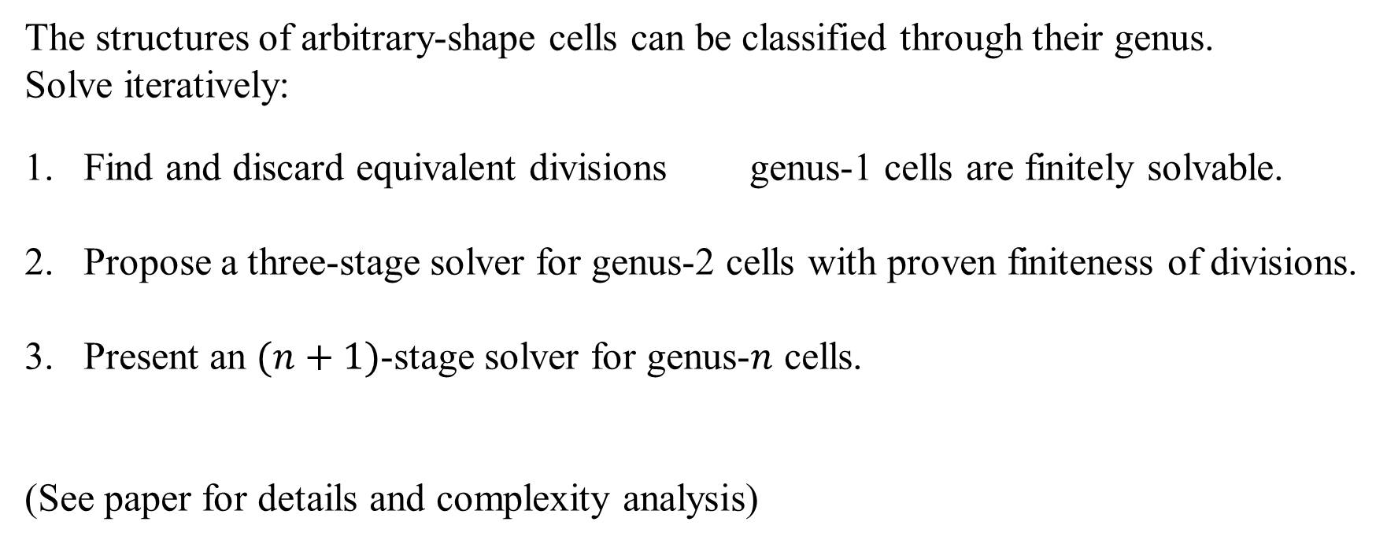
Contribution 2: A Systematic Solution of Topological Graphs
The structures of arbitrary-shape cells can be classified through their genus.
Solve iteratively:
Find and discard equivalent divisions genus-1 cells are finitely solvable.
Propose a three-stage solver for genus-2 cells with proven finiteness of divisions.
Present an $(n+1)$-stage solver for genus-$n$ cells.
(See paper for details and complexity analysis)

Slide 11
Contribution 2: A Systematic Solution of Topological Graphs Solution of Genus-1 Cells
Equivalence 1: Disconnected inner part is negligible.
All different divisions (having same cost)
Enforce connecting
cell 1 and cell 2
=
=
=
①
=
=
②
Unconnectable
area
=
①
+
②
Solve the graph without inner cell
Place the inner cell arbitrarily afterwards

Slide 12
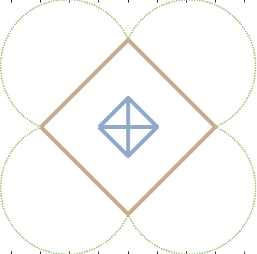
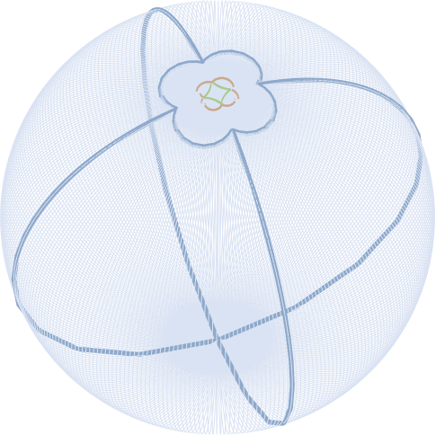
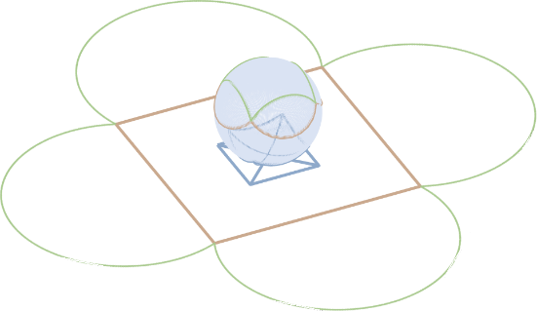
Contribution 2: A Systematic Solution of Topological Graphs Solution of Genus-1 Cells
Equivalence 2: The outer part is also negligible
A graph with a genus-1 cell
(area between two squares)
Projecting the original graph
onto sphere using
stereographic projection
Inner part and outer part interchange their roles
From equivalence 1&2:
When inner part is disconnected, inner and the outer parts are independent.

Slide 13
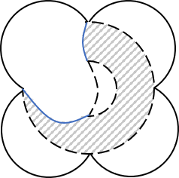
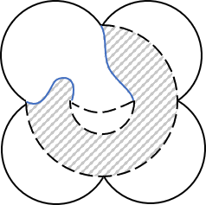
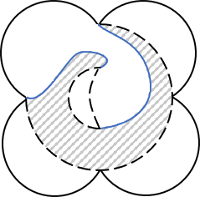
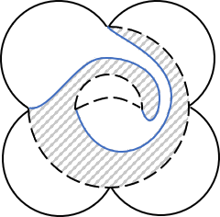











Contribution 2: A Systematic Solution of Topological Graphs Solution of Genus-1 Cells
Equivalence 3: Negligibility of cyclic cutting paths
$0$ cycle
$1$ cycle
$2$ cycles
$n$ cycles
=
=
$$⋯$$
a continuous transformation shows the equivalence
=
=
=
=
=
=
$0$ cycle
$\frac{1}{4}$ cycle
$\frac{2}{4}$ cycle
$\frac{3}{4}$ cycle
$1$ cycle
Only the acyclic situations requires explicit consideration.
Once an acyclic solution is optimal, equivalent cyclic solutions are all optimal.

Slide 14
Contribution 2: A Systematic Solution of Topological Graphs Solution of Genus-1 Cells
Equivalence 4: Negligibility of single cutting path
Connecting two inner cells
Connecting two outer cells
A contradiction
Two sides of a cutting path must have different colors, but they are the same cell!
It is not the cutting path but a connected area that transforms a genus-1 cell into simply-connected sub-cells.

Slide 15







Contribution 2: A Systematic Solution of Topological Graphs Counter Example
Connected edges do not uniquely define the structure of the cutting paths
Different structures shown by different sub-cells
Goal: enforce connection of cells 1, 3, 7, 10
$$(\left\{2\right\}, \{8, 9\})$$
$$(\left\{4, 5\right\}, \{8, 9\})$$
$$(\left\{2\right\}, \{6\})$$
$$(\left\{4, 5\right\}, \{6\})$$

Slide 16


Contribution 2: A Systematic Solution of Topological Graphs 2-Stage Process: Solution of Genus-1 Cells
Equivalence 5: The negligibility of cyclic cutting paths
Consider a two-stage process:
Stage 1: The genus-1 cell is divided into simply-connected sub-cells
Stage 2: Create further divisions
Cutting paths that start and end at the same boundary (the red one) can be seen as further divisions
The third (and later) cutting paths connecting inner and outer boundary can be seen as further divisions
Hence, in stage 1, all required cutting paths are:
2 cutting paths connecting the inner and outer part

Slide 17










Contribution 2: A Systematic Solution of Topological Graphs Example of the Solving Process
We just show in which branch will cells 1, 3, 7, 10 be connected.
Choose the edges connecting $(\left\{3, 4, 5, 1\right\}, \{10, 6, 7\})$
$$1101100$$
Let new indices in sub-cell be:
$(1, 10, 6, 7, 3, 4, 5)$
Choose the edges connecting
$$(\left\{1, 2, 3\right\}, \{10, 6, 7\})$$
$$110110$$
Let new indices in sub-cell be:
$(1, 7, 6, 10, 3, 2)$
Stage 1: Transforming the genus-one cell to simply-connected cells
(See paper for list of all divisions)
Stage 2: Further divisions

Slide 18

Contribution 2: A Systematic Solution of Topological Graphs 3-Stage Process: Solution of Genus-2 Cells
Genus-2 cell with outer boundary defined by $ω$, and inner boundaries
defined by $ω^{1}, ω^{2}$:
Stage 1: Insert $ω^{1}$ and create two cutting paths.
Stage 2: Insert $ω^{2}$ and create two cutting paths (need further equivalence).
Stage 3: Create all further divisions.

Slide 19









Contribution 2: A Systematic Solution of Topological Graphs 3-Stage Process: Solution of Genus-2 Cells
Equivalence 6: Negligibility of putting inner part on the cutting paths
$ω^{2}$ is not on cutting paths
$①$ and ② are connectable
Stage 1 has finished
$ω^{2}$ is on cutting paths
non-optimal
($①$ and ② are unconnectable)
Hence, in stage 2, only two conditions need consideration:
In sub-cell 1→ a new genus-1 cell with ${(r}_{1}+s)$ outer edges and $J_{2}$ inner edges
In sub-cell 2→ a new genus-1 cell with $\left(J_{1}+K−r_{1}−s\right)$ outer edges and $J_{2}$ inner edges

Slide 20


Contribution 2: A Systematic Solution of Topological Graphs $(n+1)$-Stage Process: Solution of Genus-$n$ Cells
Genus-$n$ cell with its outer boundaries defined by $ω$, and inner boundaries
defined $by ω^{i}, ∀i=1, ⋯, n$
Stage 1: Insert $ω^{1}$ and create two cutting paths.
Stage $i(=2, ⋯, n)$: Insert $ω^{2}$ to one of the sub-cells after stage $(i−1)$
and create two cutting paths.
Stage $(n+1)$: Create all sub-division cutting paths.

Slide 21









Contribution 2: A Systematic Solution of Topological Graphs Example of $(n+1)$-Stage Process
Init graph
Stage 1
Stage 2
Stage 3
$$⋯$$

Slide 22








Experiment : Polishing a Mobiüs Strip
Find All
Configurations
Define Colors
Create Topological
Graph
One of the Optimal
Solutions
The least number of discontinuities is 1
(note: the actual physical cutting
path is arbitrary.)

Slide 23
Experiment : Polishing a Mobiüs Strip
First Section
Going Through Discontinuity
Second Section

Slide 24








Experiment : Polishing a Swimming Ring
Find All
Configurations
Define Colors
Create Topological
Graph
One of the Optimal
Solutions
The least number of discontinuities is 1
(note: the actual physical cutting
path is arbitrary.)

Slide 25
Experiment : Polishing a Swimming Ring
First Section
Going Through Discontinuity
Second Section

Slide 26





Experiment : Polishing a “Hilly Terrain”
Find All
Configurations
Define Colors
Create Topological
Graph
One of the Optimal
Solutions
The least number of discontinuities is 1
(note: the actual physical cutting
path is arbitrary.)

Slide 27
Experiment : Polishing a “Hilly Terrain”
First Section
Going Through Discontinuity
Second Section

Slide 28
Thanks for watching
Tong Yang, Jaime Valls Miro, Yue Wang, Rong Xiong
Robotic Laboratory, Zhejiang University
Centre for Autonomous Systems (CAS), University of Technology Sydney

